Slide 1
Natural Language Inference
Компьютерная семантика
Даша Рыжова, Даша Попова
28 февраля 2023

Slide 2
Natural Language Inference
Natural Language Inference (NLI) -- задача определения логических отношений между словами, фразами, предложениями, параграфами, документами…

Slide 3
Простые примеры
Premise (Посылка) | Relation (Отношение) | Hypothesis (Гипотеза)
elephant |  | linguist
An elephant danced |  | An elephant moved
Every reptile danced |  | An elephant ate
Some elephants walk |  | No elephants move
James Byron Dean refused to move without blue jeans |  | James Dean didn’t dance without pants
Mitsubishi Motors Corp’s new vehicle sales in the US fell 46 percent in June |  | Mitsubishi’s sales rose 46 percent
Acme Corporation reported that its CEO resigned |  | Acme’s CEO resigned

Slide 4
NLI ставит задачей выявление (логических) отношений между словами (например, elephant -- linguist) и пропозициями (например, some students smoke – some students smoke cigars). В самом простом случае, отношения могут сводиться к следствию (entailment), противоречию (contradiction), отсутствию какого-либо отношения (neutral).

Slide 5
Простые примеры
Premise (Посылка) | Relation (Отношение) | Hypothesis (Гипотеза)
elephant | contradicts | linguist
An elephant danced | entails | An elephant moved
Every reptile danced | neutral | An elephant ate
Some elephants walk | contradicts | No elephants move
James Byron Dean refused to move without blue jeans | entails | James Dean didn’t dance without pants
Mitsubishi Motors Corp’s new vehicle sales in the US fell 46 percent in June | contradicts | Mitsubishi’s sales rose 46 percent
Acme Corporation reported that its CEO resigned | entails | Acme’s CEO resigned

Slide 6
NLI: формулировка задачи
Можно ли вывести из посылки (premise) гипотезу (hypothesis)?
Опора на здравый смысл, а не на формальную логику
Фокус на локальных выводах, а не на цепочках логических выводов
Упор на разнообразие лингвистических способов выражения логических отношений
Зачем нужен NLI?

Slide 7
Dagan et al. (2006)
It seems that major inferences, as needed by multiple applications, can indeed be cast in terms of textual entailment. For example, a QA system has to identify texts that entail a hypothesized answer. [...] Similarly, for certain Information Retrieval queries the combination of semantic concepts and relations denoted by the query should be entailed from relevant retrieved documents. [...] In multi-document summarization a redundant sentence, to be omitted from the summary, should be entailed from other sentences in the summary. And in MT evaluation a correct translation should be semantically equivalent to the gold standard translation, and thus both translations should entail each other. Consequently, we hypothesize that textual entailment recognition is a suitable generic task for evaluating and comparing applied semantic inference models. Eventually, such efforts can promote the development of entailment recognition "engines" which may provide useful generic modules across applications.

Slide 8
Связь с другими задачами
Задача | В терминах NLI
Paraphrase | text ≡ paraphrase
Summarization | text summary
Information retrieval | query document
Question answering | question answer Who left?⇒Someone left Someone left Dasha left

Slide 9
Лейблы
couch sofa | crow bird | bird crow | hippo hungry | elephant linguist
yes entailment |  | no non-entailment
yes entailment |  | unknown non-entailment |  | no contradiction
P ≡ Q equivalence | P Q forward | P Q reverse | P # Q non-entailment

Slide 10
Лейблы
Обычно пространство отношений разбивается на две (следствие, не-следствие), три (следствие, не-следствие, противоречие), или четыре (тождественность, включение, обратное включение, не-следствие) категории. Какой из дизайнов кажется вам наиболее перспективным? Что вы думаете по поводу расширения наименований отношений?

Slide 11
The Stanford Natural Language Inference (SNLI) Corpus
Bowman et al. 2015
Все посылки (premises) подписи из корпуса Flickr30K (Young et al. 2014).
Все гипотезы (hypotheses) получены с помощью краудсорсинга.
550,152 train examples; 10K dev; 10K test
Средняя длина в токенах:
Посылка (premise): 14.1
Гипотеза (hypothesis): 8.3
Типы клауз:
Посылка в главном предложении: 74%
Гипотеза в главном предложении: 88.9%
Размер словаря: 37,026
56,951 примеров были аннотированы дополнительными аннотаторами:
58.3% примеров получили ожидаемый лейбл отношения (gold label)
91.2% ожидаемых лейблов (gold labels) совпадают с ожидаемыми лейблами автора
0.70 общий индекс согласия между аннотаторами (Fleiss kappa)
https://nlp.stanford.edu/projects/snli/

Slide 12
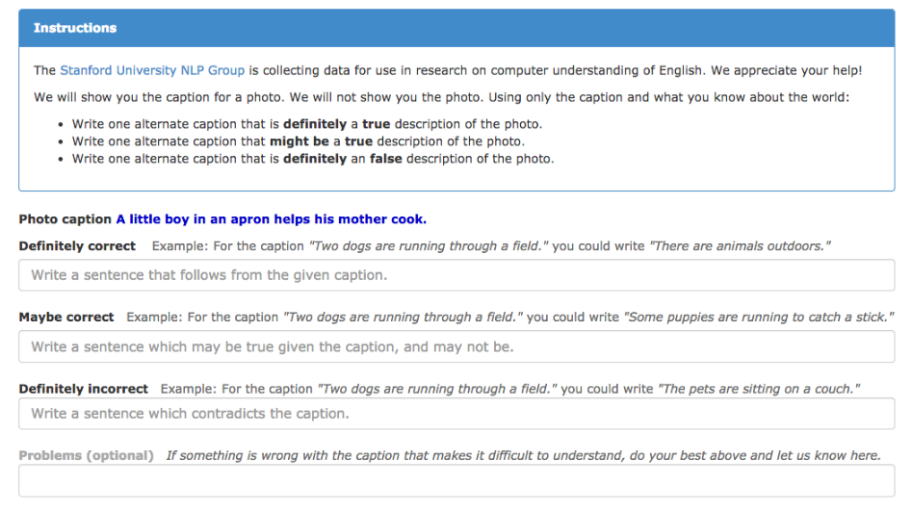

Slide 13
Примеры
Premise (Посылка) | Relation (Отношение) | Hypothesis (Гипотеза)
A man inspects the uniform of a figure in some East Asian country |  | The man is sleeping
An older and younger man smiling |  | Two men are smiling and laughing at the cats playing on the floor
A black race car starts up in front of a crowd of people |  | A man is driving down a lonely road
A soccer game with multiple males playing |  | Some men are playing a sport
A smiling costumed woman is holding an umbrella |  | A happy woman in a fairycostume holds an umbrella

Slide 14
Примеры
Premise (Посылка) | Relation (Отношение) | Hypothesis (Гипотеза)
A man inspects the uniform of a figure in some East Asian country | contradiction c c c c c | The man is sleeping
An older and younger man smiling | neutral n n e n n | Two men are smiling and laughing at the cats playing on the floor
A black race car starts up in front of a crowd of people | contradiction c c c c c | A man is driving down a lonely road
A soccer game with multiple males playing | entailment e e e e e | Some men are playing a sport
A smiling costumed woman is holding an umbrella | neutral n n e c n | A happy woman in a fairycostume holds an umbrella

Slide 15
Кореференция событий
Premise (Посылка) | Relation (Отношение) | Hypothesis (Гипотеза)
A boat sank in the Pacific Ocean. | contradiction | A boat sank in the Atlantic Ocean.
Ruth Bader Ginsburg was appointed to the Supreme Court. | contradiction | I had a sandwich for lunch today.
Если посылка и гипотеза скорее всего описывают разные фото, то лейбл -- противоречие

Slide 16
The Multi-Genre Natural Language Inference (MultiNLI) corpus
Williams et al. 2018
Train premises drawn from five genres:
Fiction: works from 1912–2010 spanning many genres
Government: reports, letters, speeches, etc., from government websites
The Slate website
Telephone: the Switchboard corpus
Travel: Berlitz travel guides
Additional genres just for dev and test (the mismatched condition):
The 9/11 report
Face-to-face: The Charlotte Narrative and Conversation Collection
Fundraising letters
Non-fiction from Oxford University Press
Verbatim: articles about linguistics
392,702 train examples; 20K dev; 20K test
19,647 examples validated by four additional annotators
58.2% examples with unanimous gold label
92.6% of gold labels match the author’s label
Project page: https://cims.nyu.edu/~sbowman/multinli/

Slide 17
The Cross-lingual Natural Language Inference (XNLI) corpus
A crowd-sourced collection of 5,000 test and 2,500 dev pairs for the MultiNLI corpus
The pairs are annotated with textual entailment and translated into 14 languages: French, Spanish, German, Greek, Bulgarian, Russian, Turkish, Arabic, Vietnamese, Thai, Chinese, Hindi, Swahili and Urdu
This results in 112.5k annotated pairs
https://cims.nyu.edu/~sbowman/xnli/

Slide 18
Veridicality Assessment
de Marneffe et al. 2012

Slide 19
Что такое веридикальность?
A lexical item L is veridical if the meaning of L applied to argument p entails the truth of p:
(1) Mary knows that Ivan smokes cigars => Ivan smokes cigars
know is a veridical predicate
(2) Mary believes that Ivan smokes cigars !=> Ivan smokes cigars
believe is a non-veridical predicate

Slide 20
The goal is to begin to identify the linguistic and contextual factors that shape readers’ veridicality judgments
The idea: lexical approaches to veridicality are only part of the bigger mechanism, and veridicality should be assessed using information from the entire sentence as well as from the context
For example, veridicality of (3) depends on whether we trust CNN:
(3) CNN reports that Prince Harry has returned to the US.

Slide 21
The FactBank
The FactBank corpus is a leading resource for research on veridicality
It provides veridicality annotations for events relative to each participant involved in the discourse
Each tag consists of a veridicality value (certain [CT], probable [PR], possible [PS], underspecified [U])
and a polarity value (positive [+], negative [−], unknown [u])
CT+ corresponds to the standard notion of veridicality,
CT− to anti-veridicality, and Uu to non-veridicality.

Slide 22
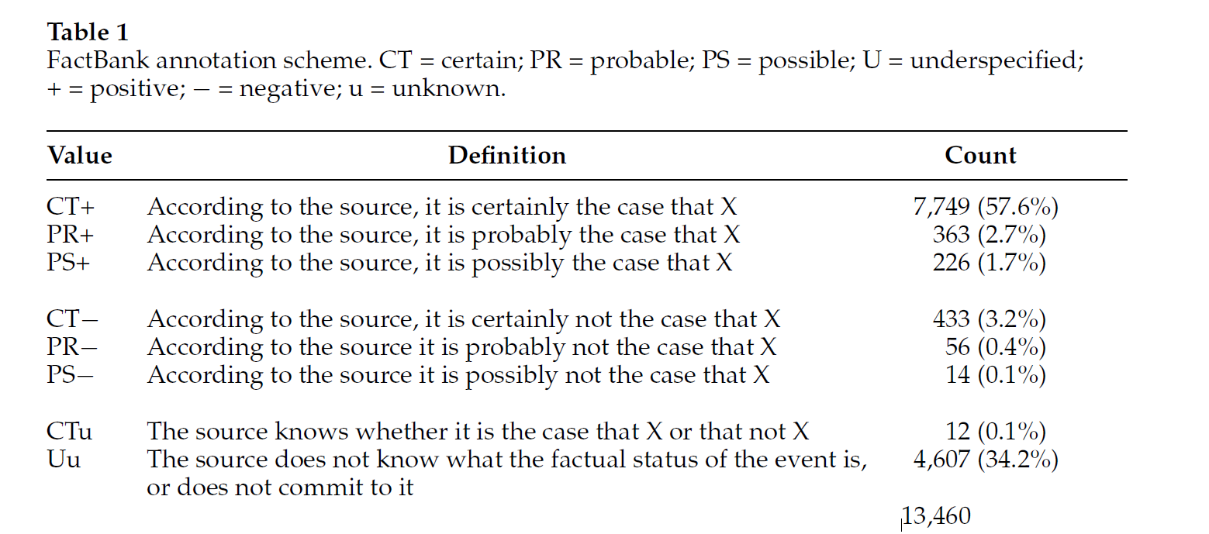
The FactBank

Slide 23
Central claims
Pragmatically informed veridicality judgments are systematic enough to be included in computational work on textual understanding
The authors seek to justify FactBank’s seven-point categorization over simpler alternatives (e.g., certain vs. uncertain, as in the CoNLL task)
The inherent uncertainty of pragmatic inference suggests to them that veridicality judgments are not always categorical, and thus are better modeled as probability distributions over veridicality categories

Slide 24
Annotations from the Reader’s Perspective
FactBank seeks to capture aspects of sentence meaning, whereas authors aim to capture aspects of utterance meaning
They extend the FactBank annotations by bringing world knowledge into the picture
They use a subset of the FactBank sentences annotated from the author’s perspective and recruit MTurkers to annotate the sentences from the reader’s perspective

Slide 25
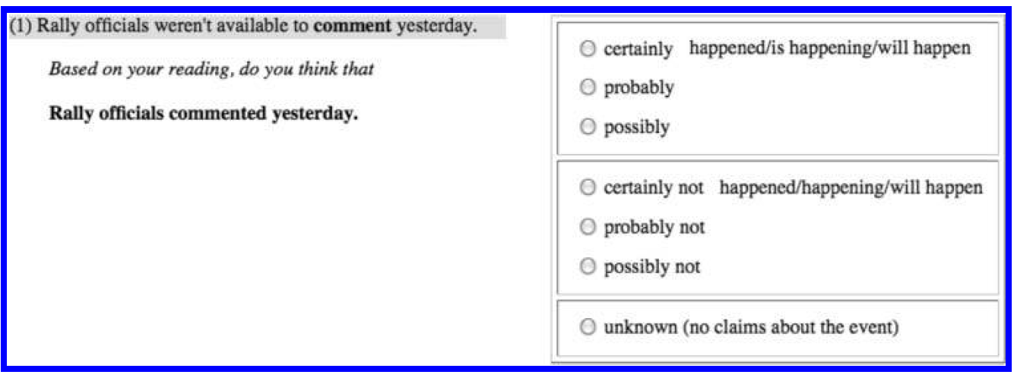
Design of the Mechanical Turk experiment

Slide 26
Annotations from the Reader’s Perspective: results
Authors collected 10 annotations for each of the 642 events, a total of 177 Turkers participated in the annotations.
At least 6 out of 10 Turkers agreed on the same tag for 500 of the 642 sentences (78%)
For 53% of the examples, at least 8 Turkers agreed with each other
Total agreement is obtained for 26% of the data (165 sentences)

Slide 27
An Alternative Scale
One of the goals is to assess whether FactBank’s seven-category scheme is the right one for the task
To this end, authors also evaluated whether a five-tag version would increase agreement and perhaps provide a better match with readers’ intuitions
Logically, PR− is equivalent to PS+, and PS− to PR+, so it seemed natural to try to collapse them into a two-way division between “probable” and “possible”

Slide 28
An Alternative Scale: results
The five-point scheme led to lower agreement between Turkers
Globally, the PR− items were generally mapped to “no”, and PS− to either “no” or “unknown”
Some Turkers chose the expected mappings (PS− to “probable” and PR− to “possible”), but only very rarely
Authors conclude from this that Saurı’s 7-point-scale comes closer than its competitors to capturing reader intuitions about veridicality

Slide 29
Lessons from the New Annotations
Although mostly authors’ experiment went in line with FactBank, some differences emerge due to pragmatic enrichment
For example, say, report, and indicate are tagged Uu in the FactBank
However, in the PragBank veridicality is more sensitive to context:
(4) In the air, U.S. Air Force fliers say they have engaged in “a little cat and mouse” with Iraqi warplanes.
This was estimated as certain by 9 of 10 Turkers

Slide 30
Lessons from the New Annotations
Another difference between the FactBank and the PragBank is the more nuanced categories for PS and PR events
In FactBank, markers of possibility or probability, such as could or likely, uniquely determine the corresponding tag
In contrast, the Turkers allow the bias created by these lexical items to be swayed by other factors
(5) Iraq could start hostilities with Israel either through a direct attack or by attacking Jordan.
Annotations: Uu: 6, PS+: 3, PR+: 1

Slide 31
Some unexpected results
Some lexical markers behave as linguistic theories predict
For example, believe is often a marker of probability whereas could and may are more likely to indicate possibility
However, sometimes pragmatics corrects it
The greatest departure from theoretical predictions occurs with the SAY category, which is logically non-veridical but correlates highly with certainty (CT+) in the new corpus
Conversely, the class KNOW, which includes know, acknowledge, and learn, is traditionally analyzed as veridical (CT+), but in the data is sometimes a marker of possibility

Slide 32
The CommitmentBank
Marie-Catherine de Marneffe, Mandy Simons, and Judith Tonhauser (2019). The CommitmentBank: Investigating projection in naturally occurring discourse. Proceedings of Sinn und Bedeutung 23.
The Data: https://github.com/mcdm/CommitmentBank

Slide 33
The CommitmentBank is a corpus of 1,200 naturally occurring discourses whose final sentence contains a clause-embedding predicate under an entailment canceling operator (question, modal, negation, antecedent of conditional)
Jane knows that it is snowing: know entails its complement, hence the speaker is committed to the complement clause (CC)
Content which is expressed under the scope of an entailment canceling operator but which is nonetheless understood to be a commitment of the speaker is said to project:
Jane doesn’t know that it is snowing.
Does Jane know that it is snowing?
Jane may know that it is snowing.
If Jane knows that it is snowing, she will wear her snow boots, hat and gloves.
The goal with the CommitmentBank has been to create a resource for the empirically-based study of projection of CCs, using naturally occurring examples and basing analysis on judgments of projection provided by theoretically untrained speakers.

Slide 34
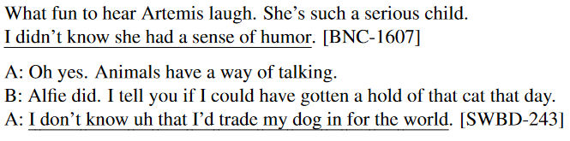
The CommitmentBank contains 1,200 examples of naturally occurring discourse segments extracted from three corpora of different genres: the Wall Street Journal (WSJ, news articles),the fiction component of the British National Corpus (BNC, fiction) and Switchboard (SWBD,dialogue).
Each discourse consists of a target sentence with a clause-embedding predicate embedded under an entailment canceling operator (negation, modal, antecedent of conditional, or question) with up to 2 prior context sentences/turns.

Slide 35
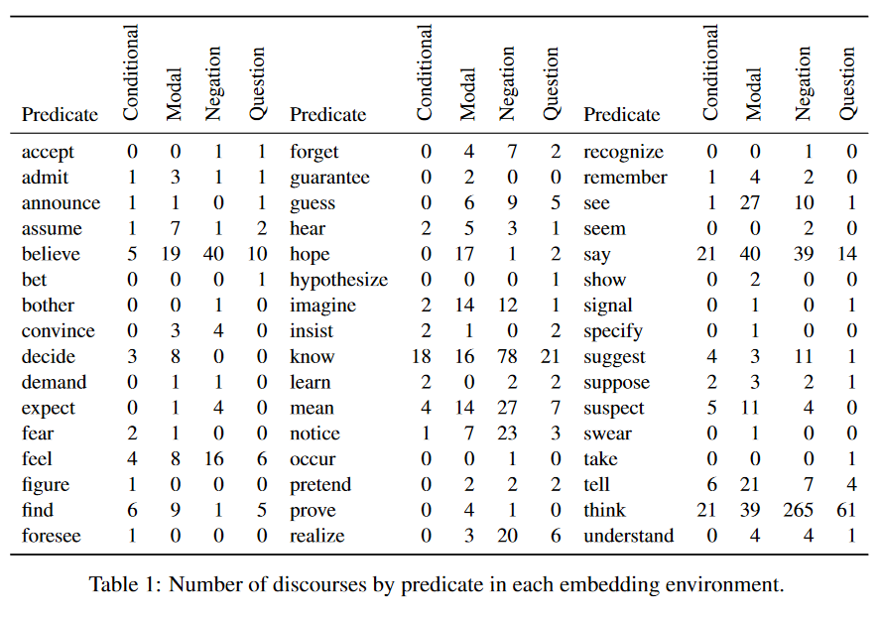

Slide 36
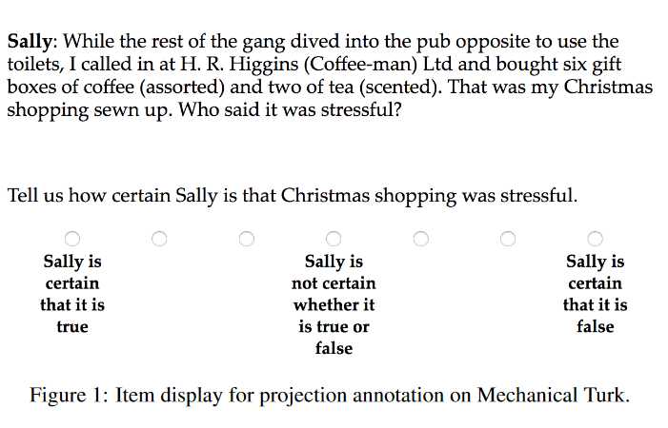

Slide 37
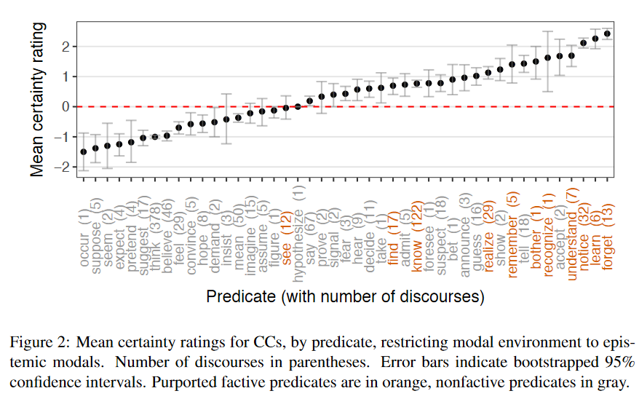

Slide 38
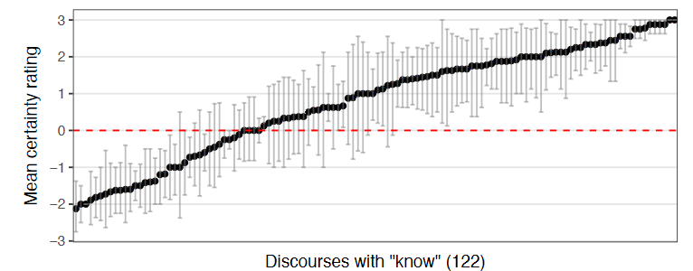

Slide 39
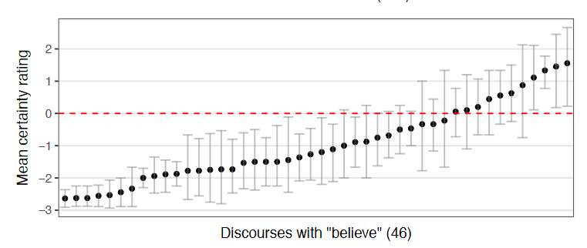

Slide 40
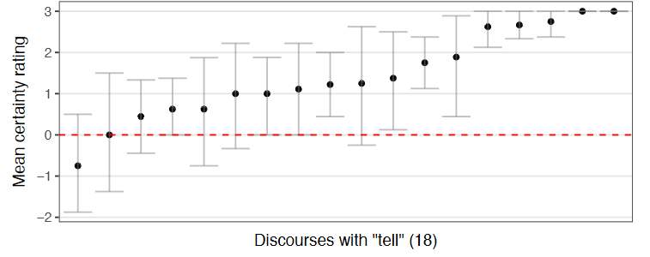

Slide 41
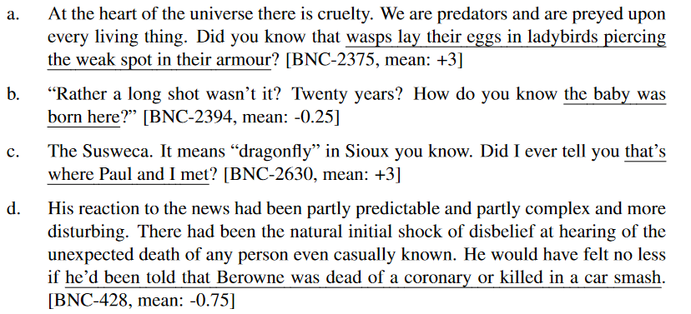
Projective or not?

Slide 42
The CommitmentBank can be recast as a dataset for NLI: https://www.aclweb.org/anthology/D19-1630.pdf

